Slide 1
Eat
Talk
Love
Prediction of star rating
from yelp reviews

Slide 2
“This pizza is AMAZING! Plus, the waiter is super cute.” → 5 ★
“Worst choice of the week.” → 1 ★

Slide 3
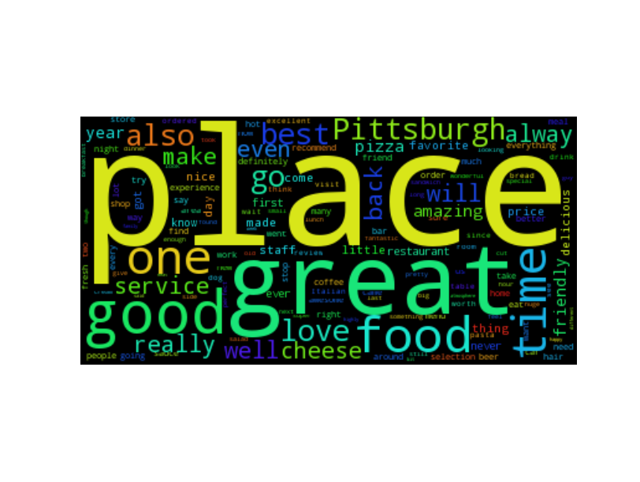
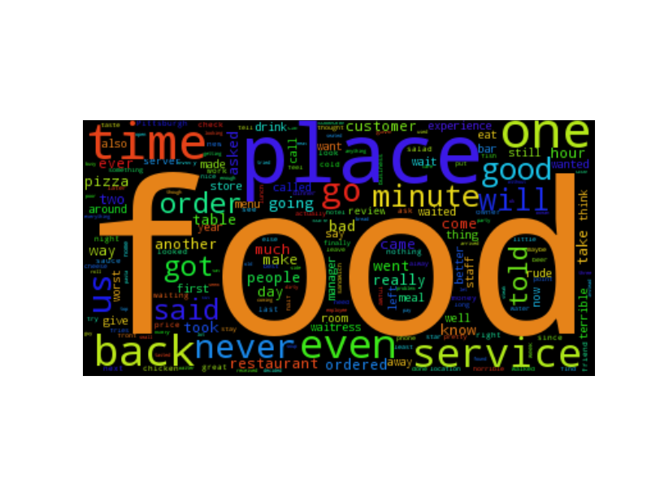
Overview of dataset
2.2M reviews by 552K users
Review : text, stars, user_id
User : review_count , average_stars, user_id, yelping_since, elite

Slide 4
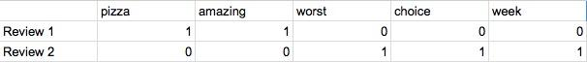
Model Selection
Why adaboost?
Less likely to overfit
Recursively change weights of features based on importance
training process selects only those features known to improve the predictive power of the model
Try out of other methods Logistic Regression: 53%
SVM: 76.81%
Adaboost with word counts
“This pizza is AMAZING!”
“Worst choice of the week.”
⬇︎
Data cleaning
⬇︎
⬇︎
Sparse matrix

Slide 5
91.91%
Accuracy rate on test set with 40K+ reviews
Notes:
Five stars: 36% +- 1 90%+

Slide 6
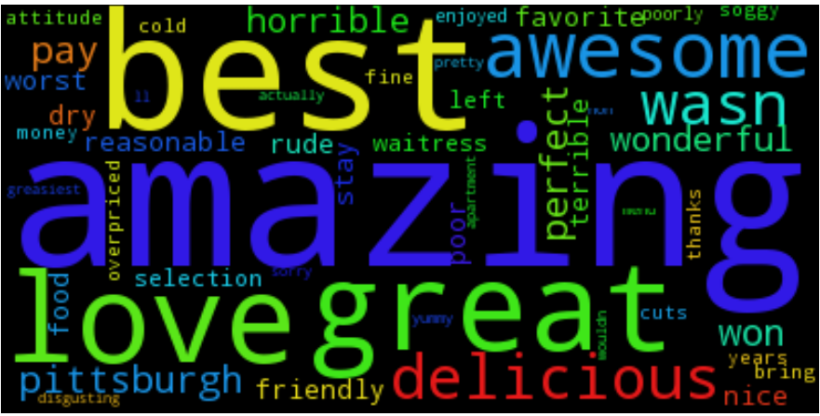
Relative importance of words
What words are important ?
Do they indicate positive or negative sentiment?
What are the frequencies of important words?
What part of speech do they belong to? Verb?Noun?Adjective?

Slide 7
Relative importance of words
What words are important?
Do they indicate positive or negative sentiment?
What are the frequencies of important words?
What part of speech do they belong to? Verb? Noun? Adjective?
Positive:
great love years needed selection best little amazing good just staff food business family want waitress
Negative:
rude terrible slow horrible left ordered told worst manager money

Slide 8
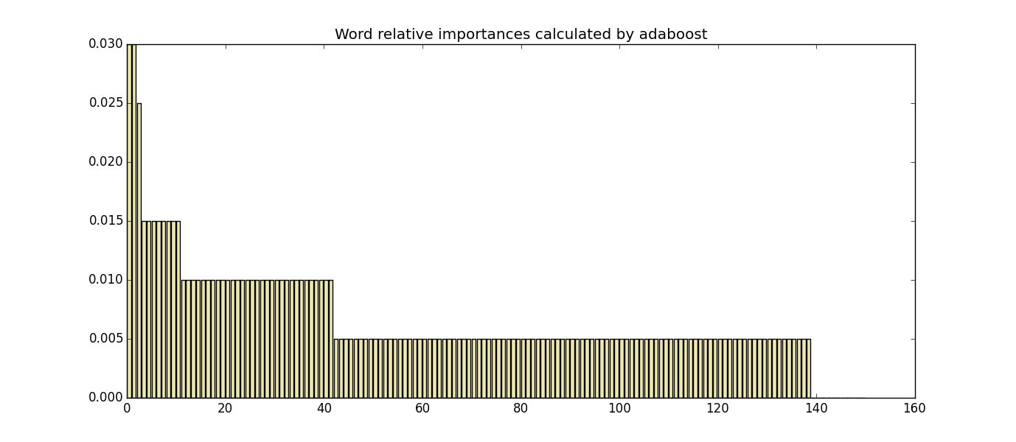
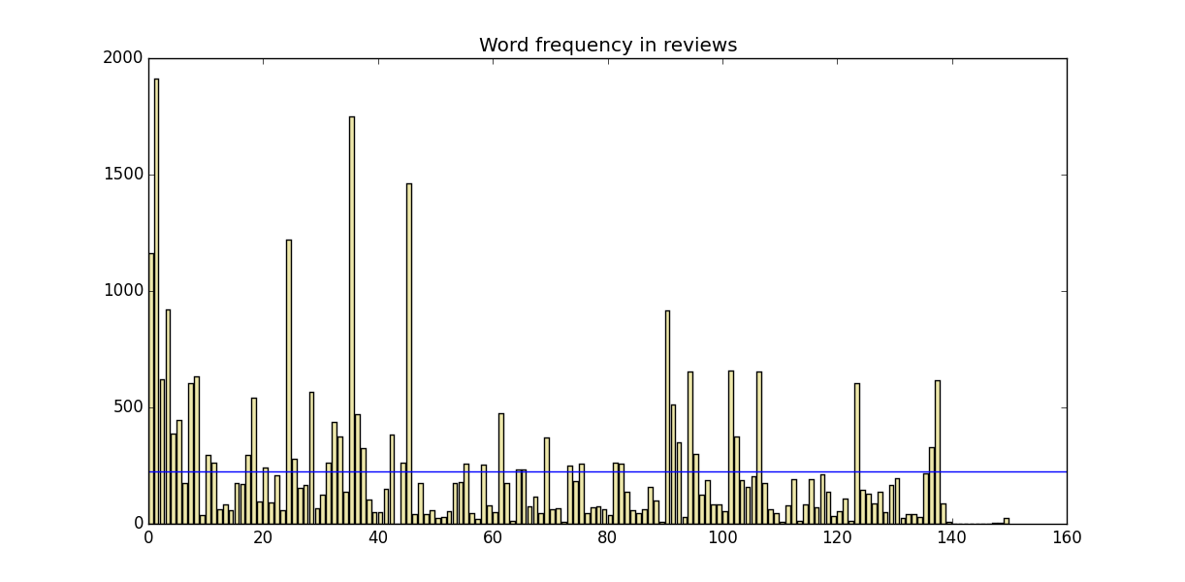
Relative importance of words
What words are important?
Do they indicate positive or negative sentiment?
What are the frequencies of important words?
What part of speech do they belong to? Verb?Noun?Adjective?

Slide 9
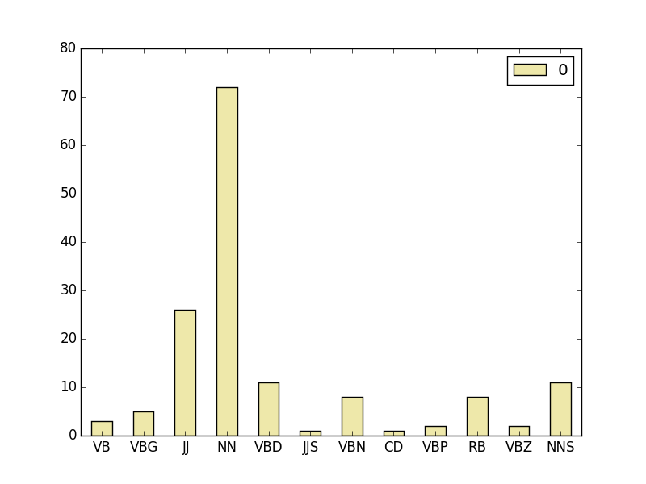
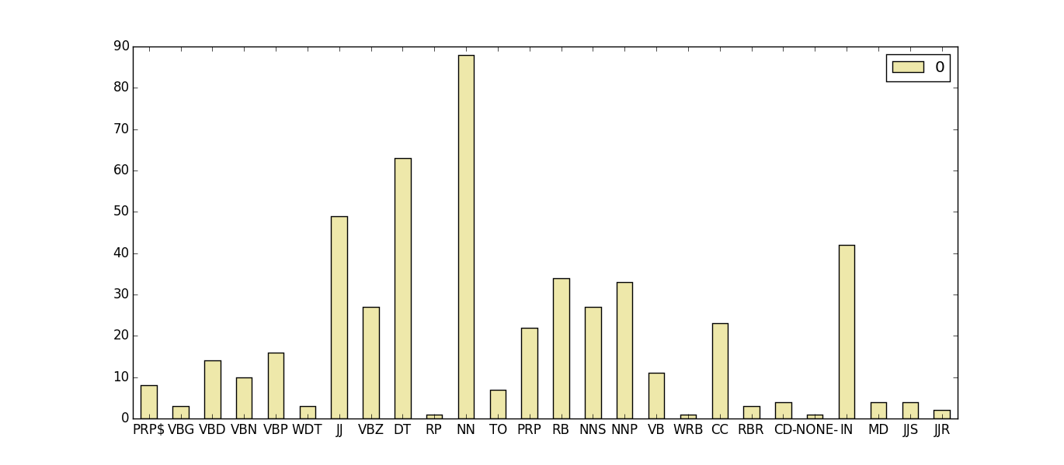
Relative importance of words
What words are important?
Do they indicate positive or negative sentiment?
What are the frequencies of important words?
What part of speech do the important words belong to?
JJ: adjective or numeral NN: noun VBD: verb, past tense VBN: verb, past participle DT: determiner(the, a, this, that,)

Slide 10
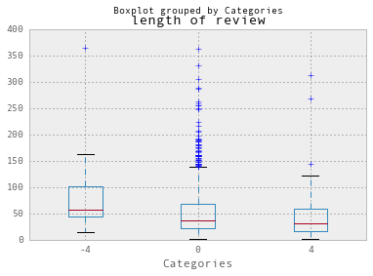
Factors related to errors
Length of review
-4: Misclassify 5★ to 1★
0: correct classification
4: Misclassify 1★ to 5★

Slide 11
“From 13.18% of the words we can detect 90% of sentiment”
- From group 20

Slide 12

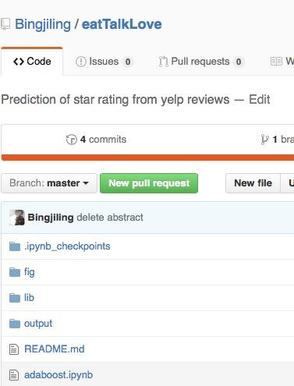
Thanks!
Github repository:
https://github.com/Bingjiling/eatTalkLove.git
Or simply search:
Eat talk love on Github

